Slide 1


MAT Consultation
30th September 2025

Slide 2
Welcome
Safety
Introductions

Slide 3
Agenda
Our Journey – Caroline Ibbotson – Chair of Governors
CGPS – Vania Eaglen - Headteacher
MTOAT – John Marston – CEO MTOAT
Questions

Slide 4
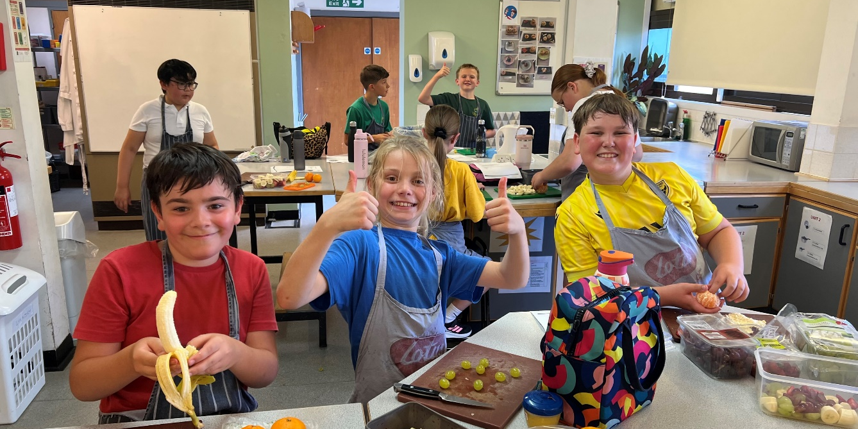
Our Journey so Far
2023 - HT requests the Governing Body explore academisation.
2024 – Governing Body debate what is best for CGPS
2024 – Governing Body working party meet and discuss partnership with several trusts and choose MTOAT who then offer a shadow year.
2024-2025 – Shadow year is completed, and Governing Body unanimously agree to start due diligence to take the next step.
TODAY – We are starting consultations as part of our due diligence.

Slide 5
Context & Current Status
Completed a shadow year
Consulting all stakeholders
Governors' decision
Notes:
Context & Current Status
NO DECISION YET – governors are consulting → want to hear YOUR views
SHADOW YEAR → spent time with MTOAT to see what it feels like
Now at the stage to look more closely, explore details, ask questions

Slide 6
Future Focused Perspective
Sustainability
Support
Thriving for future generations
Notes:
Future Focus Perspective
Not just about NOW, but securing the LONG-TERM FUTURE of CGPS
Want a school that will thrive even when we are no longer here
Future generations of children should have the same (or better) opportunities

Slide 7
Why Consider Joining a Trust?
Not financial
Sustainability, support, collaboration
Sharing good practice, ideas, learning
But…. Whilst keeping our own ethos (including C of E)
Notes:
Why Consider Joining a Trust?
NOT financial gain – though economies of scale help
About SUSTAINABILITY, SUPPORT, and COLLABORATION
Chance to share ideas with other schools, learn from each other
Still keep our IDENTITY & VALUES → Care, Grow, Persevere & Shine remain central

Slide 8
Our Journey So Far
April 2023: Governors & new Headteacher shared Ofsted & OCC concerns with regard teaching & learning, curriculum, health & safety finances
Intensive CPD internally & externally
Difficult restructure
June 2024 : Ofsted good. Proud & proof of progress!
We want to remain sustainable & stable. To do that we must look locally beyond our walls.
Notes:
Our Journey So Far
APRIL 2023 – OCC strategy review → challenges: consistency in teaching, clarity of curriculum, financial pressures
We worked INCREDIBLY HARD – CPD, restructuring, strengthening culture & ethos
JUNE 2024 – Ofsted GOOD → proud moment, proof of progress
BUT exhausting → don’t want to be in crisis mode again
Want to be SUSTAINABLE with LOCAL SUPPORT & face-to-face connections

Slide 9
Benefits for the Children
Trust wide opportunities
Strong, collaborative teaching & learning
Smooth transition
Long term future of the school
Notes:
For CHILDREN →
secure future of school;
stronger teaching & learning;
better SEND/safeguarding support;
opportunities across trust (sports, arts, events); smoother transitions

Slide 10
Benefits for the Staff
Collaboration & shared expertise
CPD & professional growth
Retain autonomy
Learn form other schools/professionals
Local network
Notes:
For STAFF →
collaboration, CPD,
professional growth;
support from peers;
while keeping autonomy to make decisions for CGPS

Slide 11
Benefits for the Community
Stability & reassurance
CGPS remains CGPS
Values & ethos remain
Stronger connections with local schools
Notes:
For COMMUNITY → reassurance that CGPS stays CGPS – our ethos, culture, and “family feel” remain

Slide 12
Benefits So Far
Leadership meetings – collaborative & supportive
SENDCo network – expertise & support
Teaching & Learning groups – curriculum initiatives
Cross-school moderation – consistency & standards
Trust-wide conferences – training, networking
Safeguarding support & best practice sharing
Notes:
Benefits Already Seen (Shadow Year)
LEADERSHIP MEETINGS → supportive, collaborative, up-to-date
SENDCo NETWORK → shared expertise across schools
TEACHING & LEARNING GROUPS → curriculum development, conferences
CROSS-SCHOOL MODERATION → consistency in assessment & standards
SAFEGUARDING SUPPORT → access to expertise & best practice
TRUST-WIDE CONFERENCE → inspiration, training, networking
Building a COLLABORATIVE NETWORK → stronger for pupils AND staff

Slide 13
Collaboration
Developing teaching and learning
Developing people
Embracing networks and support

Slide 14
Partnership
Sharing resources and people
Ensuring value for money

Slide 15
Merchant Taylors' Oxfordshire Academy Trust
MAT of three schools based in Wallingford
Committed to local community
Will only expand with the right schools

Slide 16
What will change
Trust Board is ultimately accountable
Partnership is locked in

Slide 17
What won’t change
School ethos and structures
Funding

Slide 18
Questions

